Slide 1
JDS-4
Java Design Studio - 4
Instructor
Ryan Liu
dio.ryanliu@Hotmail.com

Slide 2
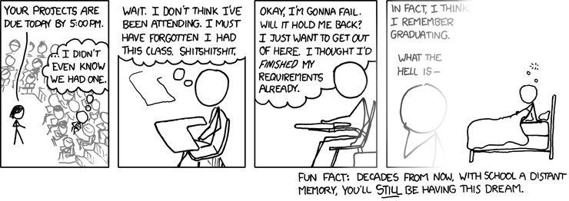
Homework
Homework for next class
Project Progress
Notes:
5 problems of difficulty “easy” from https://leetcode.com/problemset/all/
Trello progress
Ask about project progress
Check if they have achieved their goals and if they have not, ask them why not
4 people in 30 minutes -> 7.5 minutes each

Slide 3
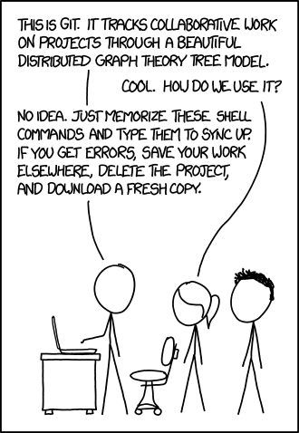
GitHub
What is GitHub?
Why do we use it?
Any experience?
Notes:
GitHub is an open source version control system meant for software development uses
What does that mean? When developers create something (an app, for example), they make constant changes to the code, releasing new versions up to and after the first official (non-beta) release.
Version control systems keep these revisions straight, storing the modifications in a central repository. This allows developers to easily collaborate, as they can download a new version of the software, make changes, and upload the newest revision. Every developer can see these new changes, download them, and contribute.

Slide 4
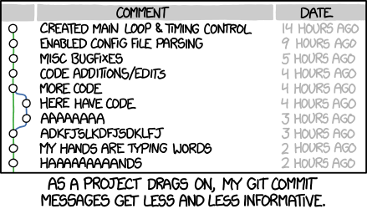
Basics
Create Repo
Commit files locally
Push files to Master Branch
Look into feature branches
Notes:
GitHub is an open source version control system meant for software development uses
What does that mean? When developers create something (an app, for example), they make constant changes to the code, releasing new versions up to and after the first official (non-beta) release.
Version control systems keep these revisions straight, storing the modifications in a central repository. This allows developers to easily collaborate, as they can download a new version of the software, make changes, and upload the newest revision. Every developer can see these new changes, download them, and contribute.

Slide 5
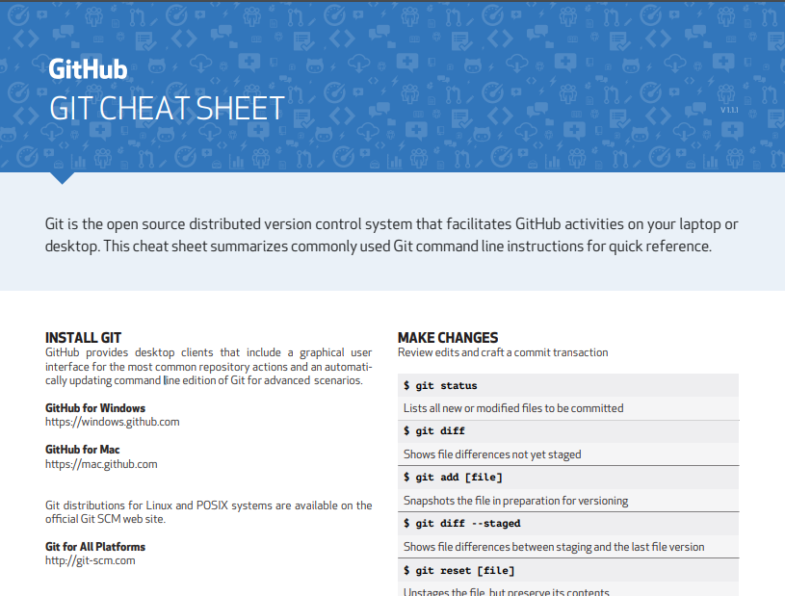
Cheat Sheet
Notes:
https://services.github.com/on-demand/downloads/github-git-cheat-sheet.pdf

Slide 6
More Homework
Continue Trello
Continue project
Push code to GitHub

